Slide 1
Deep Interactive Surface Creation from 3D Sketch Strokes
Sukanya Bhattacharjee
sukanyabhat@cse.iitb.ac.in
Parag Chaudhuri
paragc@cse.iitb.ac.in
Department of Computer Science and Engineering, IIT Bombay​

Slide 2
Outline
Introduction
Related work
Method
Training
Experiments and Results
Future Work and Conclusion
Deep Interactive Surface Creation from 3D Sketch Strokes, Sukanya Bhattacharjee, Parag Chaudhuri

Slide 3
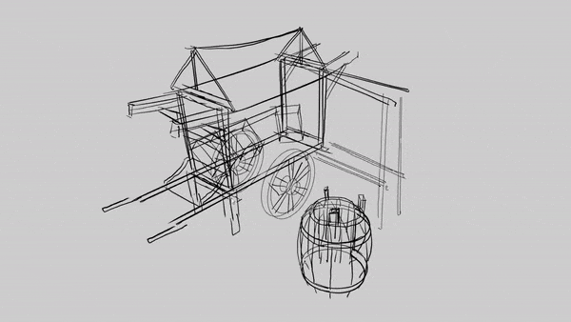
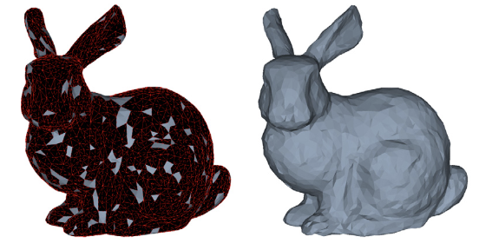
Introduction
3D Sketching:
Modelling sans ambiguity in 2D-3D translation.
Difficult to learn interaction.
Classical Surface In-painting:
Artistic input severely restricted.
Desired surface realized post in-painting.
https://www.linodriegheart.com/vehicles-blender-2-8-and-sketchbook-fun/
3D sketch to surface:
Scattered data approximation.
Regression, cubic interpolation, point cloud fitting
sub-optimal
Zhong et al., 2016
Deep Interactive Surface Creation from 3D Sketch Strokes, Sukanya Bhattacharjee, Parag Chaudhuri

Slide 4
Introduction
Our main contributions are:
Neural network based architecture, StPNet:
Input: stream of incoming 3D strokes.​
Output: 3D surface patch.
​
Interactive surface in-painting method:​
Input: patch based 3D model, sketch strokes.​
Output: patch based 3D model (in-painted).
Deep Interactive Surface Creation from 3D Sketch Strokes, Sukanya Bhattacharjee, Parag Chaudhuri

Slide 5
Related Work
3D sketch based modelling
Editing 3D model using control curves defining surface geometry [Nealen et al., 2007]
3D model guided sketching to build layered model on top of it [De Paoli and Singh, 2015]
Deep learning based object recognition to model buildings [Zhang et al. 2021]
3D sketching guided by reference 3D model to determine the sketching plane [Xu et al., 2018]
Manifold surface strips stitched to form 3D models from VR strokes [Rosales et al. 2019]
Point cloud fitting
Folding-based decoder deforms a 2D grid onto underlying 3D object surface [Yang et al., 2018]
Decomposing 3D point cloud into geometric primitives, predicts their parameter values [Sharma et al. 2020]
Editing 3D shape by sketch strokes, using CNN autoencoders deforming pre-learned 3D template of connected components [Mehr et al., 2019]
Survey:
Deep learning for 3d point clouds: A survey
[Guo et al., 2020]
Survey:​
A survey on sketch based content creation: from the desktop to virtual and augmented reality [Bhattacharjee and Chaudhuri, 2020]
Deep Interactive Surface Creation from 3D Sketch Strokes, Sukanya Bhattacharjee, Parag Chaudhuri

Slide 6
Method - StPNet
Overview of StPNet architecture
Deep Interactive Surface Creation from 3D Sketch Strokes, Sukanya Bhattacharjee, Parag Chaudhuri

Slide 7
Method - StPNet
Global surface estimate:
Deep Interactive Surface Creation from 3D Sketch Strokes, Sukanya Bhattacharjee, Parag Chaudhuri

Slide 8
Method - StPNet
Local surface estimate:
Deep Interactive Surface Creation from 3D Sketch Strokes, Sukanya Bhattacharjee, Parag Chaudhuri

Slide 9
Method - StPNet
Pre- and Post- processing- Blending StPNet:
Deep Interactive Surface Creation from 3D Sketch Strokes, Sukanya Bhattacharjee, Parag Chaudhuri

Slide 10
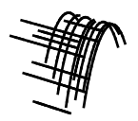
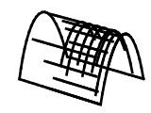
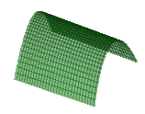
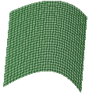
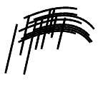
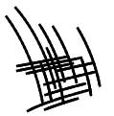
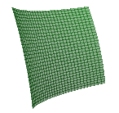
Training
Dataset:
Sketch stroke-surface patch pairs
​
Derived from:
Spline Dataset [Sharma et al., 2020]
ABC Dataset [Koch et al., 2019]
Variants:
ABCSpline
boundABCSpline
Created using Geomdl library
[Bingol and Krishnamurthy, 2019]
Strokes
(ABCSpline)
Strokes (boundABCSpline)
Surface Patch
Deep Interactive Surface Creation from 3D Sketch Strokes, Sukanya Bhattacharjee, Parag Chaudhuri

Slide 11
Training
Loss Function:
[Barrow et al., 1977]
[Sharma et al., 2020]
[Barron, 2019]
D: Dataset
S: Surface in D
P: Predicted surface
x: Point sampled from P
x̂: Point sampled from S​
||.||_{α} : α-norm​
|.| : set cardinality
Deep Interactive Surface Creation from 3D Sketch Strokes, Sukanya Bhattacharjee, Parag Chaudhuri

Slide 12
Experiments and Results
Error Metric:
[Yang et al., 2018]
Ŝ: Ground truth surface
S: Predicted surface
x̂: Point sampled from Ŝ
x: Point sampled from S
||.||₂ : L2-norm​
|.| : set cardinality
Deep Interactive Surface Creation from 3D Sketch Strokes, Sukanya Bhattacharjee, Parag Chaudhuri

Slide 13
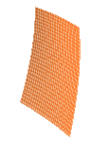
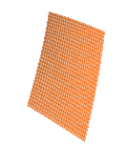
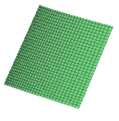
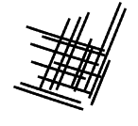
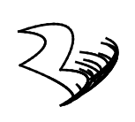
Experiments and Results
Predicted surface evolution with each incoming strokes:
ABCSpline
Input strokes
n=1
n=5
n=10
n=16
Ground Truth
boundABCSpline
Input strokes
n=4
n=8
n=12
n=20
Ground Truth
Deep Interactive Surface Creation from 3D Sketch Strokes, Sukanya Bhattacharjee, Parag Chaudhuri

Slide 14
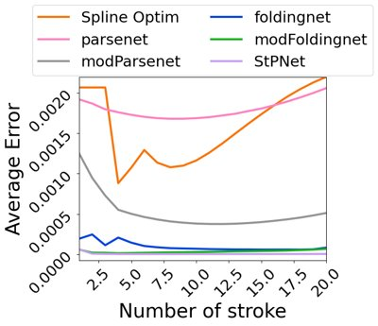
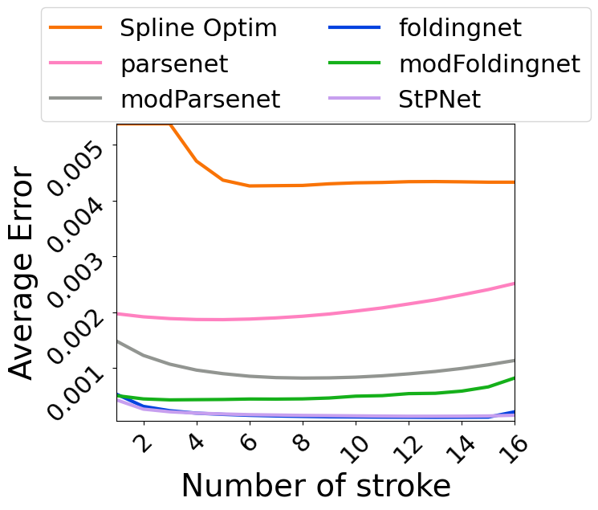
Experiments and Results
Predicted surface evolution with each incoming strokes- Error plots:
ABCSpline
boundABCSpline
Deep Interactive Surface Creation from 3D Sketch Strokes, Sukanya Bhattacharjee, Parag Chaudhuri

Slide 15
Experiments and Results
Patch Fitting Evaluation-Quantitative results:
Method | Initial surface | Loss, α | Error
SplineOptim [Bingol and Krishnamurthy, 2019] | - | - | 0.2639
Parsenet [Sharma et al., 2020] | No | 2 | 0.1510
modParsenet | Yes | 1 | 0.0683
Foldingnet [Yang et al., 2018] | No | 2 | 0.0141
modFoldingnet | Yes | 1 | 0.0495
StPNet | Yes | 1 | 0.0096
Method​ | Initial surface​ | Loss, α​ | Error​
SplineOptim ​ [Bingol and Krishnamurthy, 2019] ​ | -​ | -​ | 0.1317​
Parsenet [Sharma et al., 2020] ​ | No​ | 2​ | 0.1235​
modParsenet​ | Yes​ | 1​ | 0.0306​
Foldingnet [Yang et al., 2018] ​ | No​ | 2​ | 0.0051​
modFoldingnet​ | Yes​ | 1​ | 0.0041​
StPNet​ | Yes​ | 1​ | 0.00035​
ABCSpline
boundABCSpline
Deep Interactive Surface Creation from 3D Sketch Strokes, Sukanya Bhattacharjee, Parag Chaudhuri

Slide 16
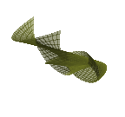
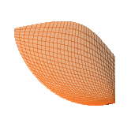
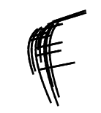
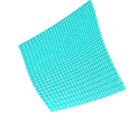
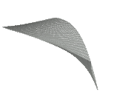
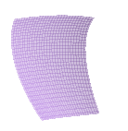
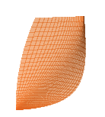
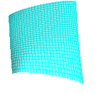
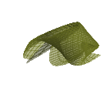
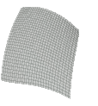
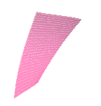
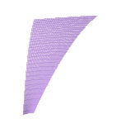
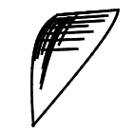
Experiments and Results
Patch Fitting Evaluation- Qualitative results:
ABCSpline
boundABCSpline
Input strokes
SplineOptim
Parsenet
modParsenet
Foldingnet
modFoldingnet
StPNet
Ground truth
Deep Interactive Surface Creation from 3D Sketch Strokes, Sukanya Bhattacharjee, Parag Chaudhuri

Slide 17
Experiments and Results
Patch Fitting - Ablation:
Initial surface estimate | Global surface estimate | Local surface estimate | Error
Yes | No | No | 0.0150
Yes | No | No | 0.0116
Yes | Yes | Yes | 0.0096
Initial surface estimate | Global surface estimate | Local surface estimate | Error
Yes | No | No | 0.00095
Yes | No | No | 0.00038
Yes | Yes | Yes | 0.00035
ABCSpline
boundABCSpline
Deep Interactive Surface Creation from 3D Sketch Strokes, Sukanya Bhattacharjee, Parag Chaudhuri

Slide 18
Experiments and Results
Patch Fitting Evaluation-Quantitative results :
Method | Initial surface | Loss, α | Error
SplineOptim [Bingol and Krishnamurthy, 2019] | - | - | 0.1732
Parsenet [Sharma et al., 2020] | No | 2 | 0.0867
modParsenet | Yes | 1 | 0.0428
Foldingnet [Yang et al., 2018] | No | 2 | 0.0135
modFoldingnet | Yes | 1 | 0.0313
StPNet | Yes | 1 | 0.0110
Method​ | Initial surface​ | Loss, α​ | Error​
SplineOptim ​ [Bingol and Krishnamurthy, 2019] ​ | -​ | -​ | 0.1050​
Parsenet [Sharma et al., 2020] ​ | No​ | 2​ | 0.0722​
modParsenet​ | Yes​ | 1​ | 0.0263​
Foldingnet [Yang et al., 2018] ​ | No​ | 2​ | 0.0100​
modFoldingnet​ | Yes​ | 1​ | 0.0098​
StPNet​ | Yes​ | 1​ | 0.0069​
ABCSplineClosed
boundABCSplineClosed
Deep Interactive Surface Creation from 3D Sketch Strokes, Sukanya Bhattacharjee, Parag Chaudhuri

Slide 19
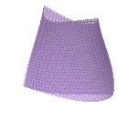
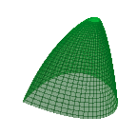
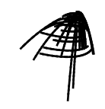
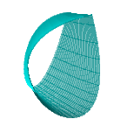
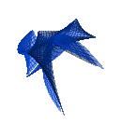
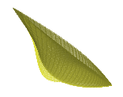
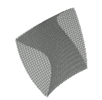
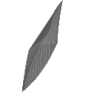
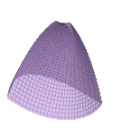
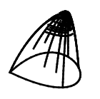
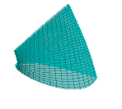
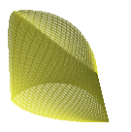
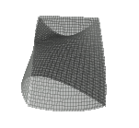
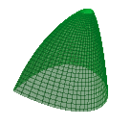
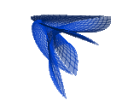
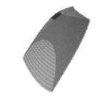
Experiments and Results
Patch Fitting Evaluation- Qualitative results:
ABCSpline
boundABCSpline
Input strokes
SplineOptim
Parsenet
modParsenet
Foldingnet
modFoldingnet
StPNet
Ground truth
Deep Interactive Surface Creation from 3D Sketch Strokes, Sukanya Bhattacharjee, Parag Chaudhuri

Slide 20
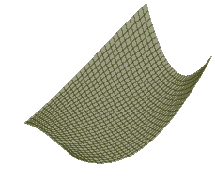
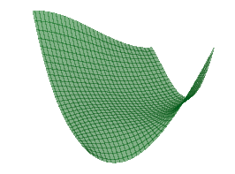
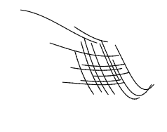
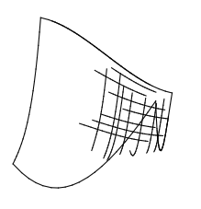
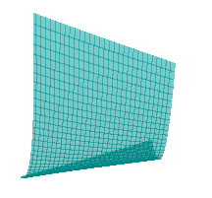
Experiments and Results
Patch Fitting Evaluation- Finetuning:
RBST
boundRBST
Input strokes
StPNet (w/o fine tune)
StPNet (fine tune)
Ground Truth
Deep Interactive Surface Creation from 3D Sketch Strokes, Sukanya Bhattacharjee, Parag Chaudhuri

Slide 21
Experiments and Results
Surface Completion- Synthetically Sampled Sketch Strokes:
Input
Ground Truth
Blending StPNet
Error Map
Utah teapot model
[Torrence, 2006]
Deep Interactive Surface Creation from 3D Sketch Strokes, Sukanya Bhattacharjee, Parag Chaudhuri

Slide 22
Experiments and Results
Surface Completion- Synthetically Sampled Sketch Strokes:
Input
Ground Truth
Blending StPNet
Error Map
Utah teapot model
[Torrence, 2006]
Deep Interactive Surface Creation from 3D Sketch Strokes, Sukanya Bhattacharjee, Parag Chaudhuri

Slide 23
Experiments and Results
Surface Completion- Synthetically Sampled Sketch Strokes:
Input
Ground Truth
Blending StPNet
Error Map
Utah teapot model
[Torrence, 2006]
Deep Interactive Surface Creation from 3D Sketch Strokes, Sukanya Bhattacharjee, Parag Chaudhuri

Slide 24
Experiments and Results
Surface Completion- Synthetically Sampled Sketch Strokes:
Model | Teapot | Teacup | Teaspoon
Average error | 0.0350 | 0.0094 | 0.0035
Bounding box dimension(averaged over all patches) - error(as percentage of bounding box dimension):
Teapot: [1.391, 1.154, 0.627] - [2.52, 3.03, 5.58]
Teacup: [0.659, 0.312, 0.635] - [1.43, 3.01, 1.48]
Teaspoon: [0.123, 0.303, 0.056] - [2.84, 1.15, 6.25]
Deep Interactive Surface Creation from 3D Sketch Strokes, Sukanya Bhattacharjee, Parag Chaudhuri

Slide 25
Experiments and Results
Surface Completion- Interactive (Real-time) Sketch Strokes:
Deep Interactive Surface Creation from 3D Sketch Strokes, Sukanya Bhattacharjee, Parag Chaudhuri

Slide 26
Experiments and Results
Major Takeaways:
Local feature extraction
how the surface changes with each stroke
compensating ambiguity caused by sparsity of input
Boundary strokes
hold significantly important features
Closed surfaces approximation
without training separately on these surfaces
reduces dependency on having closed surfaces dataset
Estimated patches from real strokes
reduce effort by users in further modifying the patch
quickly completing patch based models with rough but sparsely filled structure
Deep Interactive Surface Creation from 3D Sketch Strokes, Sukanya Bhattacharjee, Parag Chaudhuri

Slide 27
Future Work
Reduce dependency on explicitly determining boundaries of adjacent patches.
Extending our method to other classes of 3D objects.
Use our network in creation of 3D models from scratch.
Deep Interactive Surface Creation from 3D Sketch Strokes, Sukanya Bhattacharjee, Parag Chaudhuri

Slide 28
Conclusion
Propose a deep neural network based framework:
Interactive surface estimation from 3D sketch strokes.
Demonstrate its use in existing 3D content creation pipeline:
Blender plugin for in-painting of patch based 3D models.
Outperform SOTA for sparse scattered data interpolation:
Neural
Non-neural
Stability of our method with few strokes:
Handy when an artist wants to quickly repair a 3D model.
Deep Interactive Surface Creation from 3D Sketch Strokes, Sukanya Bhattacharjee, Parag Chaudhuri

Slide 29
References
[Barron, 2019] Jonathan T Barron. A general and adaptive robust loss function. In Proc. of CVPR, pages 4331–4339, 2019.
[Barrow et al., 1977] Harry G Barrow, Jay M Tenenbaum, Robert C Bolles, and Helen C Wolf. Parametric correspondence and chamfer matching: Two new techniques for image matching. Technical report, Sri International AI Center, 1977.
[Bendels et al., 2006] Gerhard H Bendels, Michael Guthe, and Reinhard Klein. Free-form modelling for surface in- painting. In Proc. of the 4th International Conference on Computer graphics, Virtual Reality, Visualisation and In- teraction in Africa, pages 49–58, 2006.
[Bhattacharjee and Chaudhuri, 2020] Sukanya Bhattachar- jee and Parag Chaudhuri. A survey on sketch based content creation: from the desktop to virtual and augmented reality. In Computer Graphics Forum, volume 39, pages 757–780. Wiley Online Library, 2020.
[Bingol and Krishnamurthy, 2019] Onur Rauf Bingol and Adarsh Krishnamurthy. NURBS-Python: An open-source object-oriented NURBS modeling framework in Python. SoftwareX, 9:85–94, 2019.
[Coons,1967] Steven A Coons.Surfacesforcomputer-aided design of space forms. Technical report, MIT Cambridge Project MAC, 1967.
[De Paoli and Singh, 2015] Chris De Paoli and Karan Singh. Secondskin: sketch-based construction of layered 3d mod- els. ACM Trans. on Graphics, 34(4):126, 2015.
[Guo et al., 2020] Yulan Guo, Hanyun Wang, Qingyong Hu, Hao Liu, Li Liu, and Mohammed Bennamoun. Deep learning for 3d point clouds: A survey. IEEE TPAMI, 2020.
[Harary et al., 2014] Gur Harary, Ayellet Tal, and Eitan Grinspun. Context-based coherent surface completion. ACM Trans. on Graphics, 33(1):1–12, 2014.
Deep Interactive Surface Creation from 3D Sketch Strokes, Sukanya Bhattacharjee, Parag Chaudhuri

Slide 30
References
[He et al., 2016] Kaiming He, Xiangyu Zhang, Shaoqing Ren, and Jian Sun. Deep residual learning for image recognition. In Proc. of CVPR, pages 770–778, 2016.
[Igarashietal.,1999] TakeoIgarashi, SatoshiMatsuoka,and Hidehiko Tanaka. Teddy: a sketching interface for 3d freeform design. In SIGGRAPH, pages 409–416. ACM, 1999.
[Koch et al., 2019] Sebastian Koch, Albert Matveev, Zhongshi Jiang, Francis Williams, Alexey Artemov, Evgeny Bur- naev, Marc Alexa, Denis Zorin, and Daniele Panozzo. Abc: A big cad model dataset for geometric deep learn- ing. In Proc. of CVPR, pages 9601–9611, 2019.
[Lui et al., 2012] Lok Ming Lui, Chengfeng Wen, and Xianfeng Gu. A conformal approach for surface inpainting. arXiv preprint arXiv:1212.0981, 2012.
[Mehr et al., 2019] Eloi Mehr, Ariane Jourdan, Nicolas Thome, Matthieu Cord, and Vincent Guitteny. Disconet: Shapes learning on disconnected manifolds for 3d editing. In Proc. of CVPR, pages 3474–3483, 2019.
[Nealen et al., 2007] Andrew Nealen, Takeo Igarashi, Olga Sorkine, and Marc Alexa. Fibermesh: designing freeform surfaces with 3d curves. In ACM SIGGRAPH 2007 papers, pages 41–50. ACM, 2007.
[Qi et al., 2017] Charles R Qi, Hao Su, Kaichun Mo, and Leonidas J Guibas. Pointnet: Deep learning on point sets for 3d classification and segmentation. In Proc. of CVPR, pages 652–660, 2017.
[Rosales et al., 2019] Enrique Rosales, Jafet Rodriguez, and Alla Sheffer. Surfacebrush: from virtual reality drawings to manifold surfaces. ACM Trans. on Graphics, 38(4):96:1–96:15, 2019.
[Sahay and Rajagopalan, 2015] Pratyush Sahay and AN Rajagopalan. Geometric inpainting of 3d structures. In Proc. of CVPR Workshops, pages 1–7, 2015.
Deep Interactive Surface Creation from 3D Sketch Strokes, Sukanya Bhattacharjee, Parag Chaudhuri

Slide 31
References
[Sharma et al., 2020] Gopal Sharma, Difan Liu, Subhransu Maji, Evangelos Kalogerakis, Siddhartha Chaudhuri, and Radom ́ır Meˇch. Parsenet: A parametric surface fitting net- work for 3d point clouds. In Proc. of ECCV, pages 261– 276. Springer, 2020.
[Smirnov et al., 2019] Dmitriy Smirnov, Mikhail Bessmelt- sev, and Justin Solomon. Deep sketch-based modeling of man-made shapes. arXiv preprint arXiv:1906.12337, 2019.
[Torrence, 2006] Ann Torrence. Martin newell’s original teapot. In ACM SIGGRAPH 2006 Teapot, pages 29–es. 2006.
[Verdera et al., 2003] Joan Verdera, Vicent Caselles, Marcelo Bertalmio, and Guillermo Sapiro. Inpainting surface holes. In Proc. of ICIP, volume 2, pages II–903. IEEE, 2003.
[Wang et al., 2019] Yue Wang, Yongbin Sun, Ziwei Liu, Sanjay E Sarma, Michael M Bronstein, and Justin M Solomon. Dynamic graph CNN for learning on point clouds. ACM Trans. On Graphics, 38(5):1–12, 2019.
[Wang et al., 2022] Shuangbu Wang, Yu Xia, Lihua You, Hassan Ugail, Alfonso Carriazo, Andres Iglesias, and Jianjun Zhang. Interactive PDE patch-based surface modeling from vertex-frames. Engineering with Computers, pages 1–19, 2022.
[Xu et al., 2018] Pengfei Xu, Hongbo Fu, Youyi Zheng, Karan Singh, Hui Huang, and Chiew-Lan Tai. Model- guided 3d sketching. IEEE TVCG, pages 2927–2939, 2018.
[Yang et al., 2018] Yaoqing Yang, Chen Feng, Yiru Shen, and Dong Tian. Foldingnet: Point cloud auto-encoder via deep grid deformation. In Proc. of CVPR, pages 206–215, 2018.
[Zhong and Qin, 2016] Ming Zhong and Hong Qin. Surface inpainting with sparsity constraints. 2016.
Deep Interactive Surface Creation from 3D Sketch Strokes, Sukanya Bhattacharjee, Parag Chaudhuri

Slide 32
Thank You!! Poster at Row 01, Stand 007
Deep Interactive Surface Creation from 3D Sketch Strokes, Sukanya Bhattacharjee, Parag Chaudhuri

